Slide 1

Genome variation and function 3
Marie Saitou
Assistant Professor, CIGENE, BIOVIT
17. Oct. 2022

Slide 2
Learning Outcomes
We will learn about:
Methods and significance of RNA sequencing
How to analyze genetic variants that are associated with gene expression (eQTL, expression QTL)

Slide 3
Discussion Review
Q: Do some literature search about the top-associated genes and assume how this gene is associated with the trait, “Short-sightedness”. To further understand the mechanism, what experiment would you plan?
Function: PRSS56 (serine protease: Type II transmembrane). This gene produces a protein that is involved during eye development.
Gene-editing in cell lines, organoid (3D cell model from Induced Pluripotent Stem (iPS) Cells), or animals
RNA-sequencing, cell development observation

Slide 4
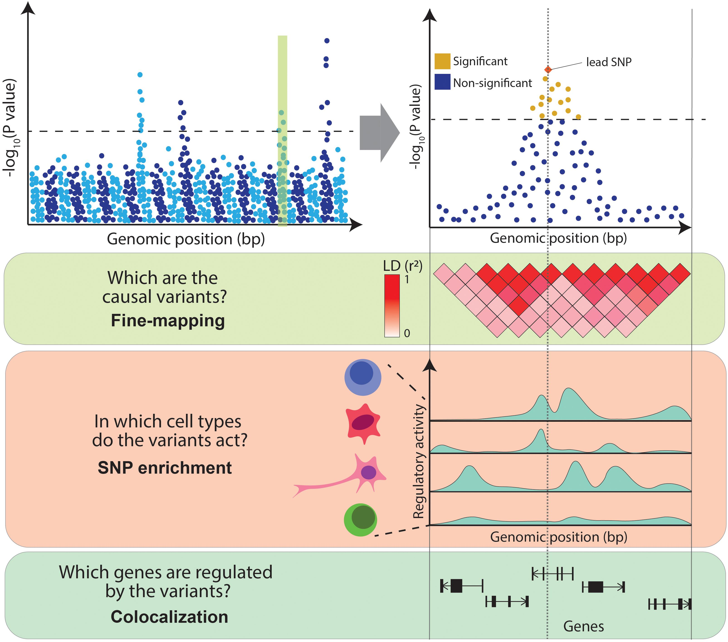
Functional genomics of molecular traits
Transcriptome anslysis – gene expression in a genome-wide manner
eQTL analysis – connect genetic variants and gene expression

Slide 5
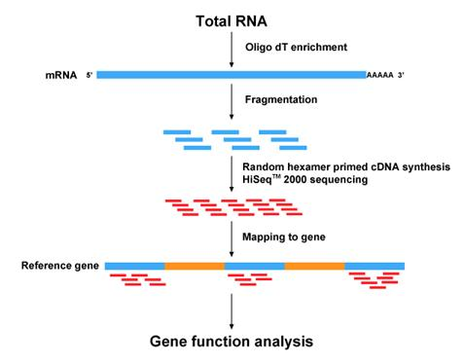
RNA-sequencing Examine the gene expression pattern in a genome-wide manner
http://bio.lundberg.gu.se/courses/vt13/rnaseq.html

Slide 6
Fold change vs p-value
Fold change is
(expression _{treated} − expression _{non-treated})
expression _{non-treated}
p-value is the probability of obtaining results as extreme as the observed results of a hypothesis test, assuming that the null hypothesis is correct.

Slide 7
Case study:
Observed expression of gene A
Observed expression of gene B
expression
expression
un-treated
treated
un-treated
treated
High fold change – high p-value
Low fold change – low p-value

Slide 8
Functional categorization of genes (Gene Ontology Analysis)

Slide 9
Transcripts Per Million (TPM) Unit of gene expression
Let’s assume that we got the following read count table.
https://www.youtube.com/watch?v=TTUrtCY2k-w&t=7s

Slide 10
geneA (2kb)
geneB (4kb)
geneC (1kb)
(1) Normalize the read counts by gene lentgh
sample1
10 reads
20 reads
5 reads
sample2
12 reads
28 reads
8 reads
sample3
30 reads
60 reads
15 reads

Slide 11
geneA (2kb)
geneB (4kb)
geneC (1kb)
(2) Normalize the read counts by total read counts
sample1
10 reads
20 reads
5 reads
sample2
12 reads
28 reads
8 reads
sample3
30 reads
60 reads
15 reads

Slide 12
geneA (2kb)
geneB (4kb)
geneC (1kb)
(3) total read counts will be one
(In reality, 1 Million)
= transcripts per million
sample1
10 reads
20 reads
5 reads
sample2
12 reads
28 reads
8 reads
sample3
30 reads
60 reads
15 reads

Slide 13
eQTL (expression quantitative trait locus) analysis
historically... QTL analysis: Conventional analysis based on limited number of genetic markers
two parental breeds are crossed
the resulting F₁ generations are self-fertilized for several generations, resulting in inbred lines
use genetic markers (100-) to distinguish between parental lines
the phenotypes and genotypes of the offspring are scored
Parent1
Parent2
DNA Marker
Actual variants
Crop genomics: advances and applications
Offspring

Slide 14
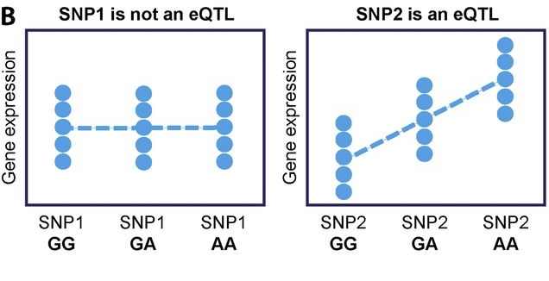
Expression Quantitative Trait Loci analysis
Variant -> Gene expression -> Phenotype
J Exp Med (2017)

Slide 15
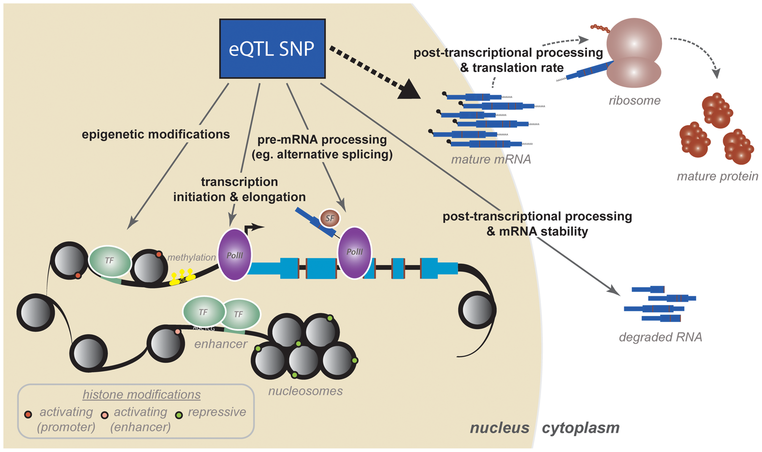
How eQTL SNPs work
Pai et al., 2015

Slide 16
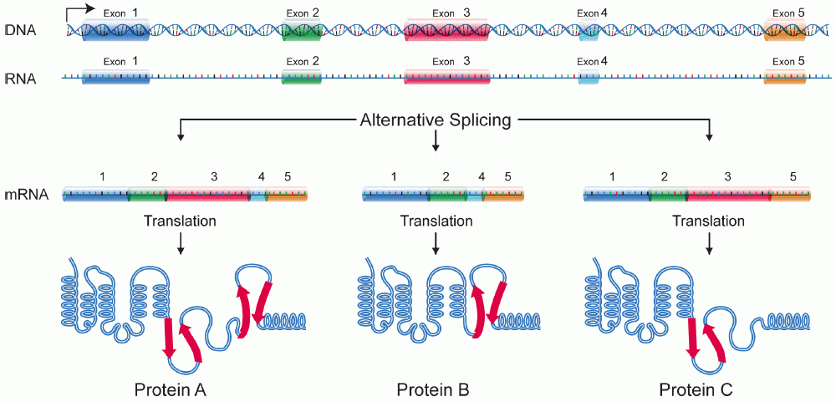
sQTL – splicing QTL Alternative Splicing allows a single gene to code for multiple proteins
Wikipedia

Slide 17
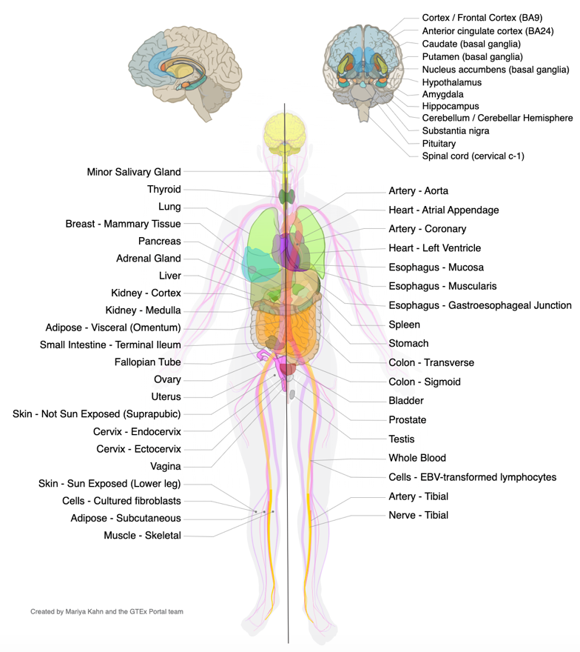
Let’s explore the GTEx Portal... Human Gene expression/splicing/eQTL database
54 tissues, 948 Donors, 17382 samples

Slide 18
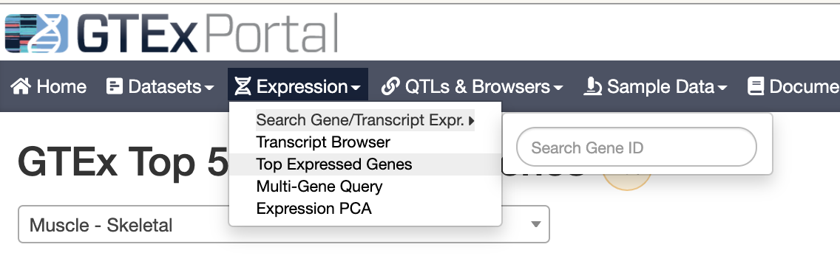
Let’s explore the GTEx Portal...
https://gtexportal.org/home/

Slide 19
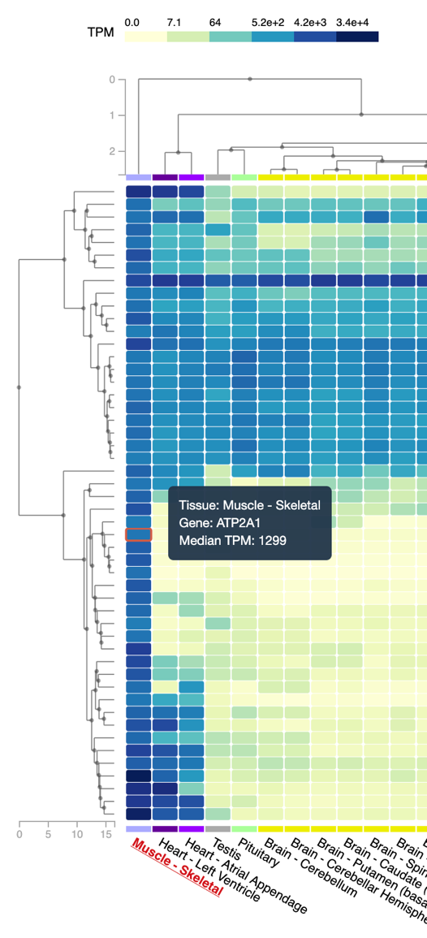
Example: highly expressed genes in muscle
TPM – blue=high expression
Housekeeping genes
(expressed everywhare)
Genes
Muscle-specific highly expressed genes
Muscle and heart -specific highly expressed genes
CKM gene
Tissues

Slide 20
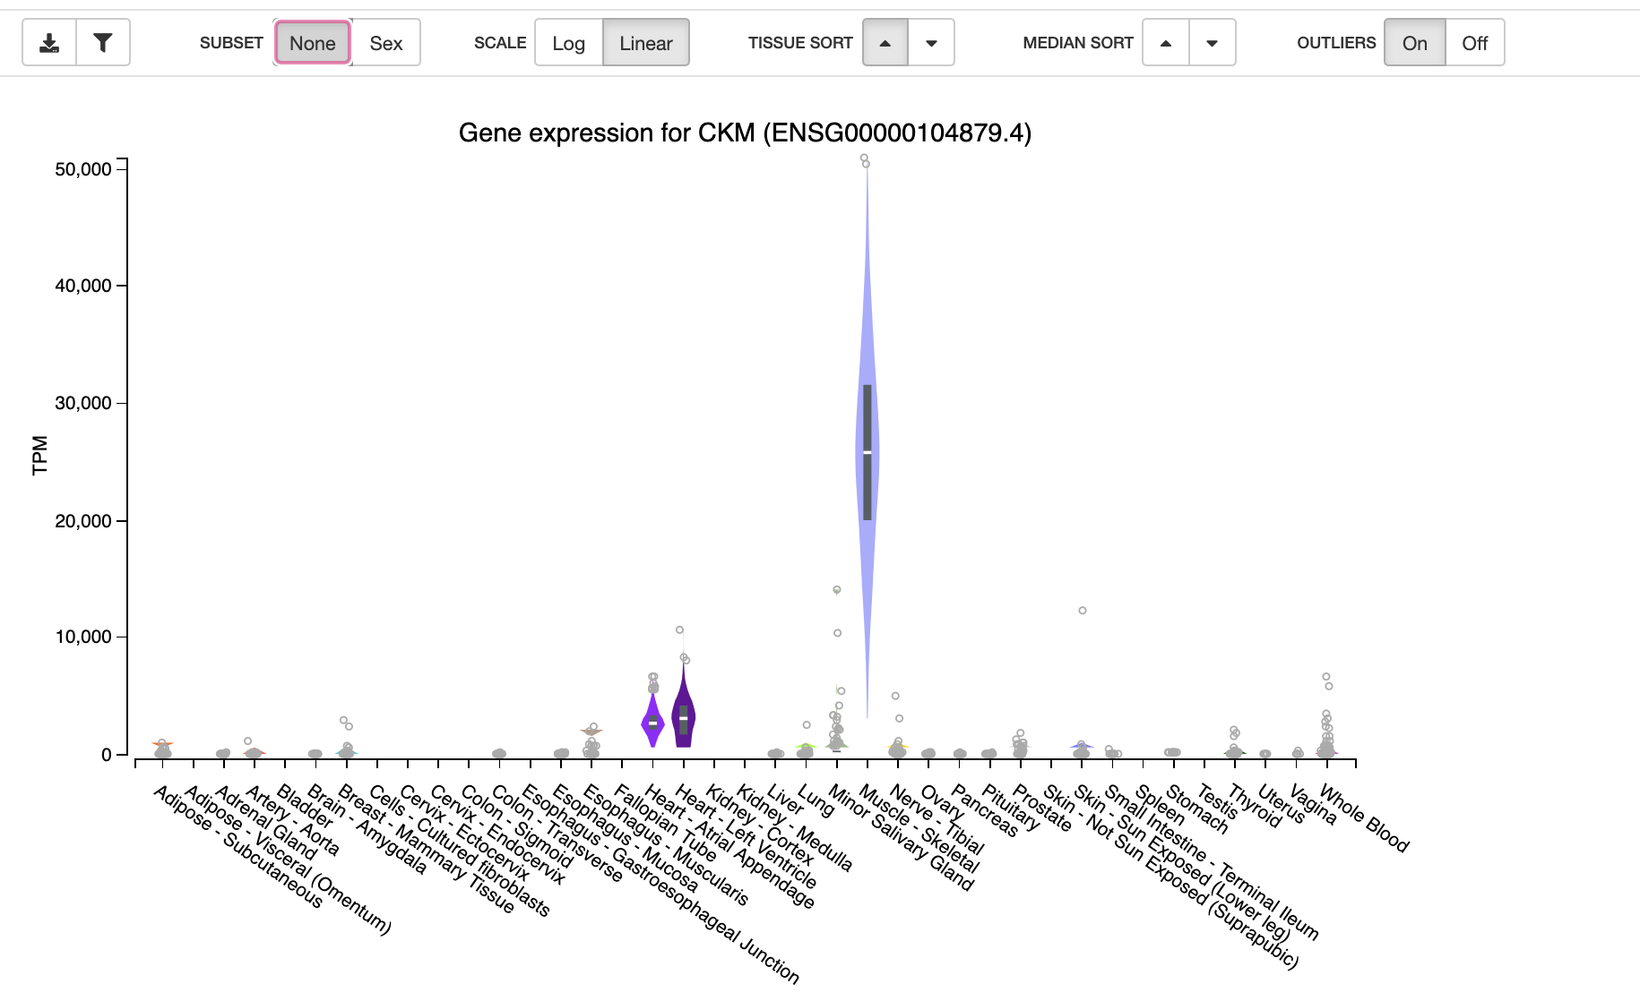


Slide 21
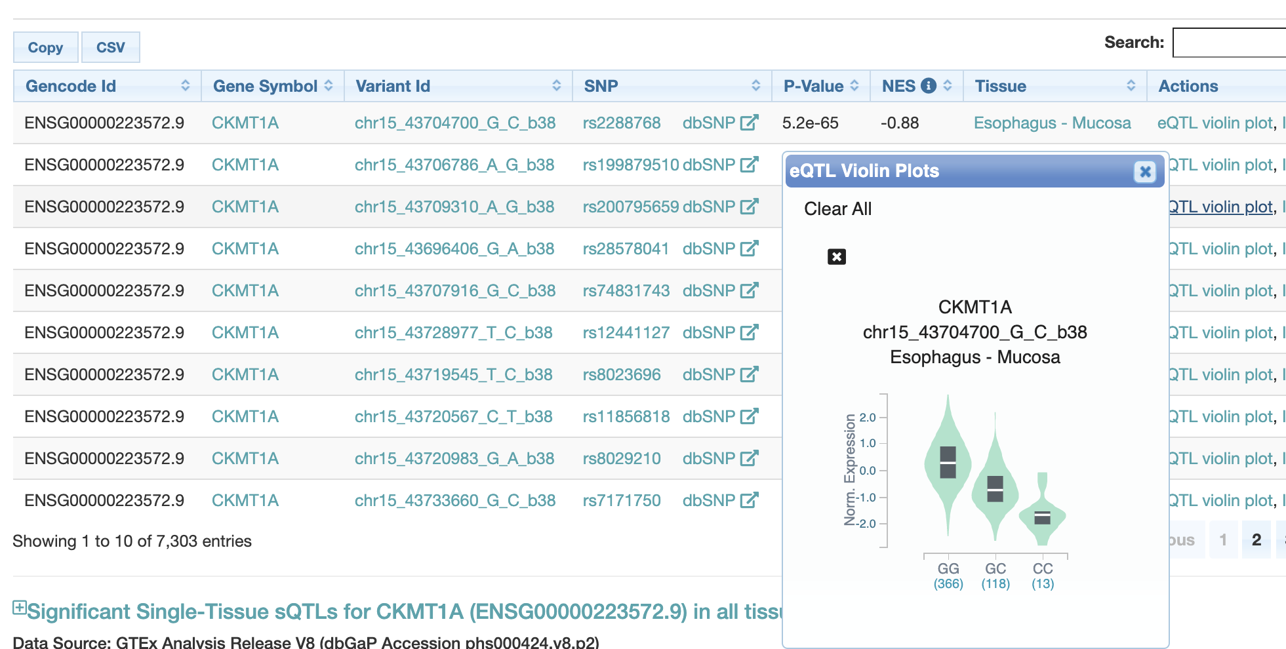
Example – CKMT1A gene expression and a variant at chr5:43504700

Slide 22
Hands-on exercise

